Slide 1
Deadlock

Slide 2
Deadlocks
System Model
Deadlock Characterization
Methods for Handling Deadlocks
Deadlock Prevention
Deadlock Avoidance
Deadlock Detection
Recovery from Deadlock
Combined Approach to Deadlock Handling
Operating System Concepts

Slide 3
Deadlock
In Multiprogramming environment, several processes are competing for number of resources. A process requests resources and if the resource is not available at that time, the process enters into waiting state. The waiting state of the processes may never again be change because the resources they are requested are held by some other waiting processes in the queue. This situation is called Deadlock.
Operating System Concepts

Slide 4
The Deadlock Problem
“Deadlocks are a set of blocked processes each holding a resource and waiting to acquire a resource held by another process.”
Example
  System has 2 tape drives.
  P₁ and P₂ each hold one tape drive and each needs another one.
Definition: “A set of processes in a deadlock state when every process in the set is waiting for an event that can only be caused by another process in the set”
Operating System Concepts

Slide 5
Bridge Crossing Example
Traffic only in one direction.
Each section of a bridge can be viewed as a resource.
If a deadlock occurs, it can be resolved if one car backs up (preempt resources and rollback).
Several cars may have to be backed up if a deadlock occurs.
Starvation is possible.
Operating System Concepts

Slide 6
System Model
Resource types R₁, R₂, . . ., R_{m}
    CPU cycles, memory space, I/O devices
Each resource type R_{i} has W_{i} instances.
Each process utilizes a resource as follows:
  request
  use
  release
Operating System Concepts

Slide 7
Deadlock Characterization
Deadlock can arise if four conditions hold simultaneously.
Mutual Exclusion: At least, one resource must be non-sharable mode. That is only one process at time can use the resource. If another process requests that resource, the requesting process must be delayed until the resource has been released.
  Resources shared such as read-only files do not lead to deadlocks but resources, such as printers and tape drives, requires exclusive access by a single process.
Hold and Wait: A Process must be holding some resource and waiting to acquire some additional resources that are currently being held by other processes.
.
Operating System Concepts

Slide 8
Deadlock Characterization
Deadlock can arise if four conditions hold simultaneously.
No Preemption: Resources cannot be preempted i.e a resource can be released only voluntarily by the process holding it, after the process has completed its task.
Circular Wait: A set {P₀,P₁,P₂,P₃,P₄………. P_{n}} of waiting process must exist such that P₀ is waiting for P₁, P₁ is waiting for P₂ and so on and P_{n} is waiting for P₀ making the circular condition.
All the above FOUR condition must occur to deadlock to occur in the
system.
The circular wait condition implies that Hold and Wait Condition, so the Four conditions are not completely independent.
Operating System Concepts

Slide 9
Resource-Allocation Graph
A set of vertices V and a set of edges E.
V is partitioned into two types:
  P = {P₁, P₂, …, P_{n}}, the set consisting of all the processes in the system.
  R = {R₁, R₂, …, R_{m}}, the set consisting of all resource types in the system.
request edge – directed edge P_{i} → R_{j}
assignment edge – directed edge R_{j} → P_{i}
Operating System Concepts

Slide 10
Resource-Allocation Graph (Cont.)
Process
Resource Type with 4 instances
P_{i} requests instance of R_{j}
P_{i} is holding an instance of R_{j}
P_{i}
R_{j}
P_{i}
R_{j}
Operating System Concepts

Slide 11

Example of a Resource Allocation Graph
Example:
P = {P₁, P₂, P₃}
R = {R₁, R₂ , R₃, R₄}
E = { P₁ →R1, P2→R3, R1→P2, R2→P2, R2→P1, R3→P3}
There are ONE, TWO, ONE and THREE instances of R₁, R₂ , R₃ and R₄ type resources.
Operating System Concepts

Slide 12

Resource Allocation Graph With A Deadlock
Operating System Concepts

Slide 13

Resource Allocation Graph With A Cycle But No Deadlock
Operating System Concepts

Slide 14
Basic Facts
If graph contains no cycles ⇒ no deadlock.
If graph contains a cycle ⇒
  if only one instance per resource type, then deadlock.
  if several instances per resource type, possibility of deadlock.
Operating System Concepts

Slide 15
Methods for Handling Deadlocks
We can deal the deadlock in one of the THREE ways:
Do not allow the system to get into a deadlocked State: [Deadlock Prevention and Avoidance]. By using protocol to prevent or avoid deadlocks ensuring that the system will never enter a deadlock state.
We can allow the system to enter a deadlock state, detecting it and recovering it. [Deadlock detection and recovery]. Abort a process or preempt some resources when deadlocks are detected.
Ignore the problem all together
Operating System Concepts

Slide 16
Deadlock Prevention:
For a deadlock to occur, each of the four necessary conditions must hold. By ensuring that at least one these four conditions cannot hold, we can prevent the occurrence of deadlock.
Mutual Exclusion: This condition must hold for non-sharable resources. Sharable resources on the other hand, do not require mutually exclusive access and thus cannot be involved in a deadlock.
A process never needs to wait for sharable resources. In general, we cannot prevent deadlocks by denying the mutual exclusion condition: some resources are intrinsically Non-sharable.
Operating System Concepts

Slide 17
Cont….
Hold and Wait: To ensure that this condition never occurs in the system, we must guarantee that whenever process request a resource, it does not hold any other resource.
“One Protocol that can be used requires each process to request and be allocated all its resources before it execution. We can implement this provision by requiring that system calls requesting other resources for a process precede all other system call. “
“An Alternative protocol allows a process to request a resource only when the process has none. A process may request some resources and use them. Before it can request any additional resources, however it must release all the resources that it is currently allocated”
There are TWO disadvantages of this protocol
Low Resource Utilization
Starvation

Slide 18
No Preemption: There should be No Preemption of Resources that has already been allocated. To ensure this, we can use the following protocol:
“If a Process is holding some resources and requests another resources that cannot be immediately allocated to it (that is Process must wait), then all resources currently being held are preempted.
In other words, these resources are implicitly released. The preempted resources are added to the list of resources for which the process is waiting. The process will be restated only when it can regain its old resources as well as the new ones that it is requesting”

Slide 19
Circular Wait: To ensure that this condition never holds is to impose to total ordering of all resources types and to require that each process requests resources in an increasing order of enumeration.
R = {R₀, R₁, R₂….. R_{m}} be the set of resource type. We assign to each resources type a unique integer number, which allows us to compare two resources and to determine whether one precedes another in our ordering.
For example: - F (Tape Drive) =1
F( Disk Drive ) = 5;
F( Printer) = 12,

Slide 20
The following protocol is used to prevent deadlock:
“Each process can request resources only in an increasing order of enumeration. That is, a process can initially request any number of instances of a resource type say R_{i}. After that the process can request instances of resources type R_{j} if and only if F(R_{j}) > F(R_{i}).
If several instances of the same resources type are needed, a single request for all of them must be issued”
“Alternatively, we can require that whenever a process requests an instances of resources type R_{j}, it has released any resources R_{i} such that F(R_{i}) >= F(R_{j}).”
If these two protocols are used, then the circular wait condition cannot hold.

Slide 21
Deadlock Prevention PROTOCOLS: (Short Notes)
Mutual Exclusion:
Sharable resources and non-sharable are intrinsic property of the resource type cannot be changed. This problem can be overcome by adding more instances of the resources.
Hold and Wait
  Conservative Property
  Do not Hold
No Preemption
  Forceful Preemption
Circular Wait
  Order of Acquisition of Resource

Slide 22
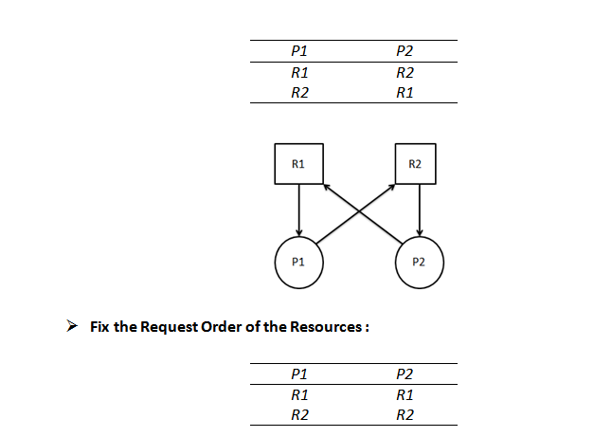
Order of Acquisition of Resource

Slide 23
Deadlock Avoidance
System Requires some additional a priori information available.
Simplest and most useful model requires that each process declare the maximum number of resources of each type that it may need.
The deadlock-avoidance algorithm dynamically examines the resource-allocation state to ensure that there can never be a circular-wait condition.
Resource-allocation state is defined by the number of available and allocated resources, and the maximum demands of the processes.
Operating System Concepts

Slide 24
Safe State
When a process requests an available resource, system must decide if immediate allocation leaves the system in a safe state.
System is in safe state if there exists a safe sequence of all processes.
Sequence <P₁, P₂, …, P_{n}> is safe if for each P_{i}, the resources that Pi can still request can be satisfied by currently available resources + resources held by all the P_{j}, with j<I.
  If P_{i} resource needs are not immediately available, then P_{i} can wait until all P_{j} have finished.
  When P_{j} is finished, P_{i} can obtain needed resources, execute, return allocated resources, and terminate.
  When P_{i} terminates, P_{i+1} can obtain its needed resources, and so on.
Operating System Concepts

Slide 25
Basic Facts
If a system is in safe state ⇒ no deadlocks.
If a system is in unsafe state ⇒ possibility of deadlock.
Avoidance ⇒ ensure that a system will never enter an unsafe state.
Operating System Concepts

Slide 26

Safe, Unsafe , Deadlock State
Operating System Concepts

Slide 27
Resource-Allocation Graph Algorithm
Claim edge P_{i} → R_{j} indicated that process P_{j} may request resource R_{j}; represented by a dashed line.
Claim edge converts to request edge when a process requests a resource.
When a resource is released by a process, assignment edge reconverts to a claim edge.
Resources must be claimed a priori in the system.
Operating System Concepts

Slide 28

Resource-Allocation Graph For Deadlock Avoidance
Operating System Concepts

Slide 29

Unsafe State In Resource-Allocation Graph
Operating System Concepts

Slide 30
Banker’s Algorithm
Multiple instances.
Each process must a priori claim maximum use.
When a process requests a resource it may have to wait.
When a process gets all its resources it must return them in a finite amount of time.
Operating System Concepts

Slide 31
Data Structures for the Banker’s Algorithm
Let n = number of processes, and m = number of resources types.
Available: Vector of length m. If available [j] = k, there are k instances of resource type R_{j} available.
Max: n x m matrix. If Max [i,j] = k, then process P_{i} may request at most k instances of resource type R_{j}.
Allocation: n x m matrix. If Allocation[i,j] = k then P_{i} is currently allocated k instances of R_{j.}
Need: n x m matrix. If Need[i,j] = k, then P_{i} may need k more instances of R_{j} to complete its task.
    Need [i,j] = Max[i,j] – Allocation [i,j].
Operating System Concepts

Slide 32
Safety Algorithm
1. Let Work and Finish be vectors of length m and n, respectively. Initialize:
      Work = Available
      Finish [i] = false for i - 1,3, …, n.
2. Find and i such that both:
  (a) Finish [i] = false
  (b) Need_{i} ≤ Work
  If no such i exists, go to step 4.
3. Work = Work + Allocation_{i}
Finish[i] = true
go to step 2.
4. If Finish [i] == true for all i, then the system is in a safe state.
Operating System Concepts

Slide 33
Resource-Request Algorithm for Process P_{i}
Request = request vector for process P_{i}. If Request_{i} [j] = k then process P_{i} wants k instances of resource type R_{j.}
  1. If Request_{i} ≤ Need_{i} go to step 2. Otherwise, raise error condition, since process has exceeded its maximum claim.
  2. If Request_{i} ≤ Available, go to step 3. Otherwise P_{i} must wait, since resources are not available.
  3. Pretend to allocate requested resources to P_{i} by modifying the state as follows:
      Available = Available - Request_{i};
      Allocation_{i} = Allocation_{i} + Request_{i};
      Need_{i} = Need_{i} – Request_{i;;}
    If safe ⇒ the resources are allocated to P_{i}.
    If unsafe ⇒ P_{i} must wait, and the old resource-allocation state is restored
Operating System Concepts

Slide 34
Example of Banker’s Algorithm
5 processes P₀ through P₄; 3 resource types A
(10 instances),
B (5instances, and C (7 instances).
Snapshot at time T₀:
Allocation Max Available
A B C A B C A B C
P₀ 0 1 0 7 5 3 3 3 2
P₁ 2 0 0 3 2 2
P₂ 3 0 2 9 0 2
P₃ 2 1 1 2 2 2
P₄ 0 0 2 4 3 3
Operating System Concepts

Slide 35
Example (Cont.)
The content of the matrix. Need is defined to be Max – Allocation.
Need
A B C
P₀ 7 4 3
P₁ 1 2 2
P₂ 6 0 0
P₃ 0 1 1
P₄ 4 3 1
The system is in a safe state since the sequence < P₁, P₃, P₄, P₂, P₀> satisfies safety criteria.
Operating System Concepts

Slide 36
Example P₁ Request (1,0,2) (Cont.)
Check that Request ≤ Available (that is, (1,0,2) ≤ (3,3,2) ⇒ true.
Allocation Need Available
A B C A B C A B C
P₀ 0 1 0 7 4 3 2 3 0
P₁ 3 0 2 0 2 0
P₂ 3 0 1 6 0 0
P₃ 2 1 1 0 1 1
P₄ 0 0 2 4 3 1
Executing safety algorithm shows that sequence <P₁, P₃, P₄, P₀, P₂> satisfies safety requirement.
Can request for (3,3,0) by P₄ be granted?
Can request for (0,2,0) by P₀ be granted?
Operating System Concepts

Slide 37
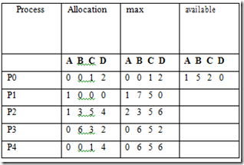
What is the Need matrix?
Is Safe sequence exist? What is the safe sequence?
Suppose P1 make an additional request for <0,4,2,0>. Can the extra request granted immediately?

Slide 38
Numerical
Considering a system with five processes P₀ through P₄ and three resources types A, B, C. Resource type A has 10 instances, B has 5 instances and type C has 7 instances. Suppose at time t₀ following snapshot of the system has been taken:
Find the Need Matrix?
Find whether system is in Deadlock or not? Write the safe sate ( if Possible)
What will happen if process P₁ requests one additional instance of resource type A and two instances of resource type C? Is additional request by process P1 granted?
Process | Maximum Need | Allocation
 | A B C | A B C
P0 | 7 5 3 | 0 1 0
P1 | 3 2 2 | 2 0 0
P2 | 9 0 2 | 3 0 2
P3 | 2 2 2 | 2 1 1
P4 | 4 3 3 | 0 0 2

Slide 39
Deadlock Detection
Allow system to enter deadlock state
Detection algorithm
Recovery scheme
Operating System Concepts

Slide 40
Single Instance of Each Resource Type
Maintain wait-for graph
  Nodes are processes.
  P_{i} → P_{j} if P_{i} is waiting for P_{j}.
Periodically invoke an algorithm that searches for a cycle in the graph.
An algorithm to detect a cycle in a graph requires an order of n² operations, where n is the number of vertices in the graph.
Operating System Concepts

Slide 41

Resource-Allocation Graph and Wait-for Graph
Resource-Allocation Graph
Corresponding wait-for graph
Operating System Concepts

Slide 42
Detection-Algorithm Usage
When, and how often, to invoke depends on:
  How often a deadlock is likely to occur?
  How many processes will need to be rolled back?
    one for each disjoint cycle
If detection algorithm is invoked arbitrarily, there may be many cycles in the resource graph and so we would not be able to tell which of the many deadlocked processes “caused” the deadlock.
Operating System Concepts

Slide 43
Recovery from Deadlock: Process Termination
Abort all deadlocked processes.
Abort one process at a time until the deadlock cycle is eliminated.
In which order should we choose to abort?
  Priority of the process.
  How long process has computed, and how much longer to completion.
  Resources the process has used.
  Resources process needs to complete.
  How many processes will need to be terminated.
  Is process interactive or batch?
Operating System Concepts

Slide 44
Recovery from Deadlock: Resource Preemption
Selecting a victim – minimize cost.
Rollback – return to some safe state, restart process for that state.
Starvation – same process may always be picked as victim, include number of rollback in cost factor.
Operating System Concepts

Slide 45
Combined Approach to Deadlock Handling
Combine the three basic approaches
  prevention
  avoidance
  detection
allowing the use of the optimal approach for each of resources in the system.
Partition resources into hierarchically ordered classes.
Use most appropriate technique for handling deadlocks within each class.
Operating System Concepts

Slide 46
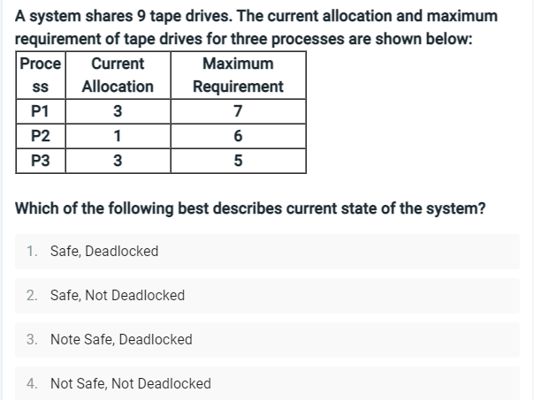
Q1

Slide 47


